Slide 1
Engineered Materials
(SC221)

Slide 2


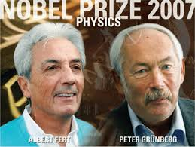
The "giant magnetoresistive" (GMR) effect was discovered in the
late 1980s by two European scientists working independently: Peter Gruenberg and Albert Fert. This won them a Nobel prize in Physics, in 2007.
They saw very large resistance changes in the materials comprised of alternating very thin layers of various metallic elements.

Slide 3
GMR is a quantum mechanical effect
It is observed in multilayers composed of alternating ferromagnetic and non-magnetic conductive layers (Fe/Cr layers)
a significant change in the electrical resistance of such multilayered material is observed depending on whether the magnetization of adjacent ferromagnetic layers are in a parallel or an antiparallel alignment.

Slide 4
Multilayer GMR
In a multilayer GMR two or more ferromagnetic layers are separated by a very thin (about 1 nm) non-ferromagnetic spacer (e.g., Fe/Cr/Fe).
At certain thicknesses, the coupling between adjacent ferromagnetic layers becomes antiferromagnetic, making it energetically preferable for the magnetizations of adjacent layers to align in anti-parallel.
Resistance is reported to change by 50% and more if coupling spacing goes above 3 nm.

Slide 5
History
Exactly 150 years ago W. Thomson (Lord Kelvin) measured the behaviour of the resistance of iron and nickel in the presence of a magnetic field.
He wrote “I found that iron, when subjected to a magnetic force, acquires an increase of resistance to the conduction of electricity along, and a diminution of resistance to the conduction of electricity across, the lines of magnetization”.
This difference in resistance between the parallel and perpendicular case is called anisotropic magnetoresistance (AMR). It is now known that this property originates from the electron spin-orbit coupling. In general magnetoresistance effects are very small, at most of the order of a few percent.

Slide 6
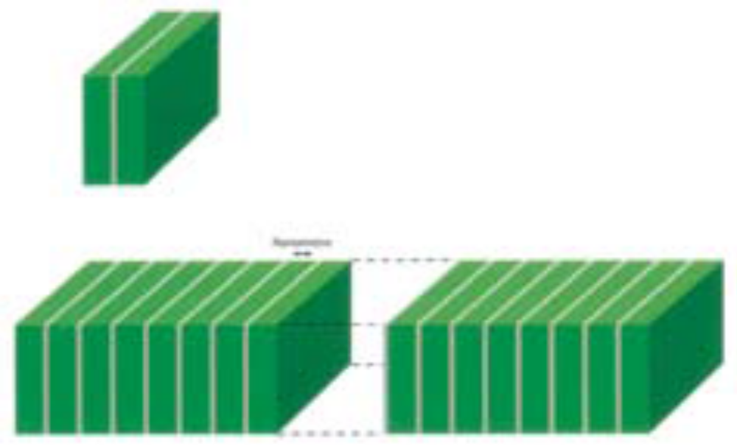
What was the Nobel Prize Winning Experiment?
The discovery of GMR one group, led by Peter Grünberg [Germany], used a trilayer system Fe/Cr/Fe, while the other group, led by Albert Fert (France) used a multilayer stack as shown in the figure below.
Schematic figure of magnetic multilayers. Nanometre thick layers of iron (green) are separated by nanometre thick spacer layers of a second metal (for example chromium or copper). The top figure illustrates the trilayer Fe/Cr/Fe used by Grünberg’s group, and the bottom the multilayer (Fe/Cr)_{n}, with n as high as 60, used by Fert’s group.

Slide 7
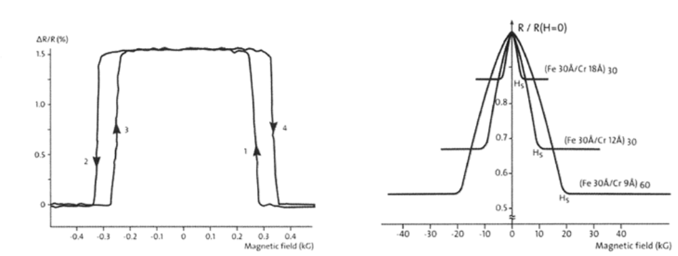
What did they
observe?
Left: Magnetoresistance measurements [3] (room temperature) for the trilayer system Fe/Cr/Fe. To the far right as well as to the far left the magnetizations of the two iron layers are both parallel to the external magnetic field. In the intermediate region the magnetizations of the two iron layers are antiparallel. The experiments also show a hysteresis behaviour (difference 1 and 4 (2 and 3)) typical for magnetization measurements.
Right: Magnetoresistance measurements [4] (4.2K) for the multilayer system (Fe/Cr)n . To the far right (>HS , where HS is the saturation field) as well as to the far left (< – HS ) the magnetizations of all iron layers are parallel to the external magnetic field. In the low field region every second iron layer is magnetized antiparallel to the external magnetic field. 10 kG = 1 Tesla. By changing the spacer (Cr) thickness from 18 A to 9 A, Fert reported the change in MR (R/R_{H=0}) from 15 to 50%.

Slide 8
Ferromagnet material
‘d’ transition metals
Fe (z=26), Co (z=27), Ni (z=28)
‘f’ transition metals
Gadolinium, Gd (z=64)
3d and 4f electrons (valence) decide their properties.
Also, electrons spin also play a formidable role in this new phenomena of MR.

Slide 9
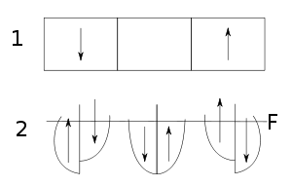
Electronic density of states (DOS) in magnetic and non-magnetic metals. 1: the structure of two ferromagnetic and one non-magnetic layers (arrows indicate the direction of magnetization). 2: splitting of DOS for electrons with different spin directions for each layer (arrows indicate the spin direction). F: Fermi level. The magnetic moment is antiparallel to the direction of total spin at the Fermi level.

Slide 10
The overall resistance is relatively low for parallel alignment and relatively high for antiparallel alignment.
The magnetization direction can be controlled, for example, by applying an external magnetic field.
The GMR effect is based on the dependence of electron scattering on the spin orientation.
A new term has emerged with the invent of GMR and that is “spin current” instead of “charge current”.
Spintronics is a new area.

Slide 11
The GMR material changes its electrical resistance in response to an applied magnetic field.
The electron scattering depends on the relative orientations of the
electron spins and those magnetic moments: it is weakest when they are parallel and strongest when they are antiparallel.
Numerically GMR is characterized as
δH = [R(H) - R(0)]/R(0)
where R(H) is the resistance of the sample in a magnetic field H,
and R(0) corresponds to H = 0.

Slide 12
The term "giant magnetoresistance" indicates that the value δ
for multilayer structures significantly exceeds the anisotropic
magnetoresistance, which has a typical value within a few percent.
The enhancement of δ_{H} became possible with the advent of sample preparation techniques such as molecular beam epitaxy (MBE), which allows manufacturing multilayer thin films with a thickness of several nanometers.

Slide 13
Resistance
An electrical current of electrons sent through a metallic system will always experience a resistance R.
This happens primarily because of 2 reasons:
  electron-phonon interaction
  Scattering of free-electrons with defect and impurity atoms
The only electrons that participate in the electrical conduction process are those at (or very close to) the Fermi level
Conductivity of transition elements (ferromagnetic materials, such as Fe, Co, Ni) is mainly determined by the 4s electrons which are easily mobile due to the wide energy range of the bands derived from the 4s-states

Slide 14
Resistance
In a ferromagnet there are 2 types of carriers:
  Spin-up &
  Spin-down electrons
Their density of states at the Fermi level is quite different causing a significant difference in spin-dependent resistance
Two points are important to note that to obtain well-behaved metallic multilayers:
  the lattice parameters for the different metallic layers must match
  And both have the same crystal structure.
This is the case for chromium and iron, where both metals adapt the bcc crystal structure and where in addition they have very similar lattice spacing.

Slide 15
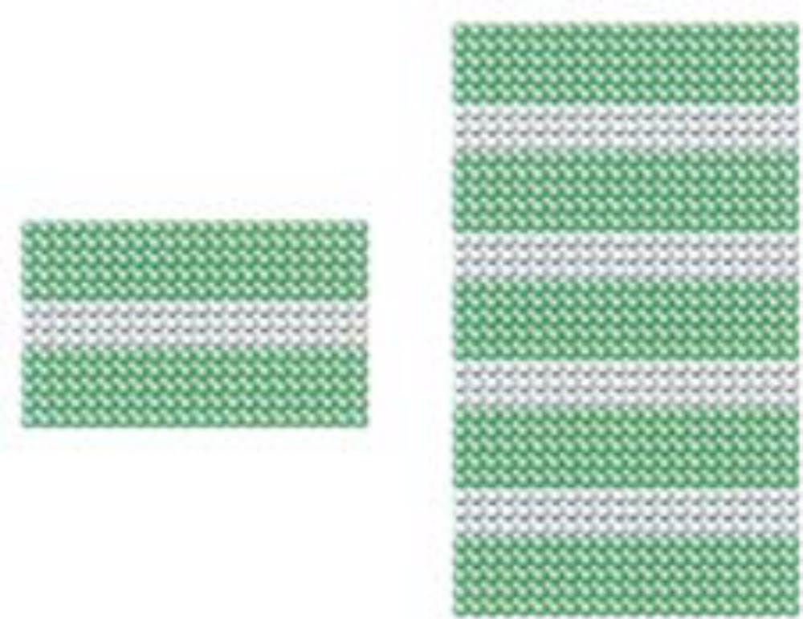

Slide 16
Resistance
In order to exhibit the GMR effect the mean free path length for the conduction electrons has to greatly exceed the interlayer separations so that the electrons can travel through magnetic layers and pick up the GMR effect.
1980s onward we had that capability. It was now possible to grow multilayers where the spatial separation between the magnetic layers is of the order of nanometres.
The important role of the electrons of the non-magnetic layer(s) is that they provide the coupling mechanism between the magnetic layers

Slide 17
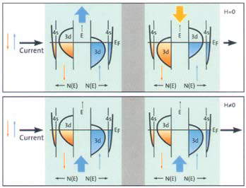
Schematic illustration of the electronic structure of a trilayer system with two ferromagnetic layers (light green) on both sides separated by nonmagnetic material (grey).
The top figure: The case without external magnetic field (H=0), i.e., when the two magnetic layers have opposite magnetizations (indicated by the thick blue and orange arrows.
The bottom figure: The case when an external magnetic field (H ≠ 0) has forced the two magnetizations to be parallel (two thick blue arrows at the bottom of the lower figure. The magnitude of the four magnetizations is the same.

Slide 18
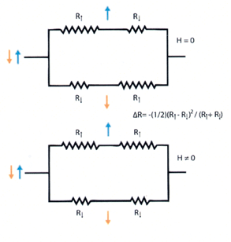
The same physical system as previous Fig. The magnetic layers are now represented by resistances R↑ and R↓. This shows very clearly that the total resistance for the two cases are different, i.e., there is a magnetoresistance effect.
In case R↑ >> R↓ it is practically only the lowest of the four possibilities which will permit a current.
In the lower picture with parallel magnetizations the resistance for the spin up (spin down) electrons will be R↑ (R↓) in both magnetic layers. In the upper picture with antiparallel magnetizations the spin up (spin down) electrons will have a resistance R↑ (R↓) in the first magnetic layer to the left. In the second magnetic layer the resistance for the spin up (spin down) electron will be R↑(R↓), since the magnetization environment has here become totally opposite compared to the first magnetic layer.

Slide 19
Applications of GMR:
The main application is magnetic field sensors and hence it is used for the following:
Read data in hard disk drives, biosensors, microelectromechanical systems (MEMS) and other devices
Magnetoresistive random-access memory (MRAM)
Read data in biosensors
https://www.youtube.com/watch?v=wteUW2sL7bc

Slide 20
Spin Valve GMR
In spin valve GMR two ferromagnetic layers are separated by a thin non-ferromagnetic spacer (around 3 nm).
We increase the distances over which an electron will retain its spin (the spin relaxation length), and enhance the polarization effect on electrons by the ferromagnetic layers and the interface.
This device is sometimes also called a spin valve.

Slide 21
Further Readings
- Kristen Coyne, E.S. "Giant Magnetoresistance: The Really Big Idea
Behind a Very Tiny Tool"
- Tsymbal, E.Y. and D. Pettifor, "Perspectives of giant
magnetoresistance"
- IBM using GMR to store on hard disk https:
//www.research.ibm.com/research/demos/gmr/index.html

